Slide 1
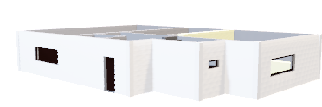
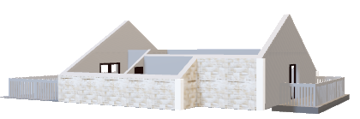
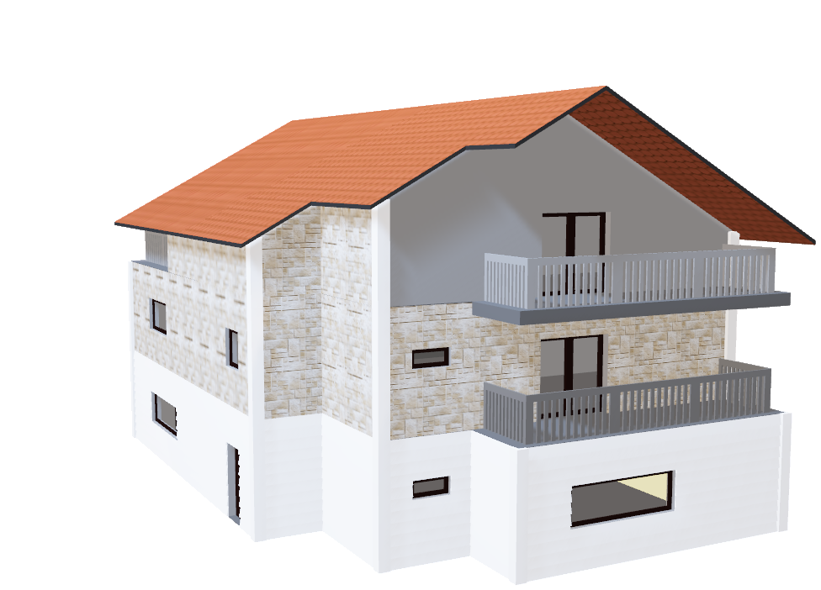
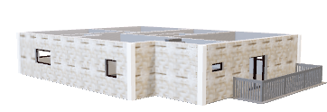
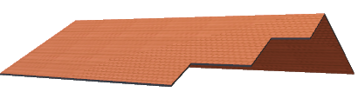
Aws Bassyoni
General Assembly DS Part Time
11/5/2020
Predicting Housing Prices in Ames, Iowa.

Slide 2
Goal
Build a model to predict housing prices using different regression techniques such as Linear Regression and Decision Trees
The sampled data is a representative of Ames total housing market
The dataset is relatively small
Assumptions & Limitations

Slide 3
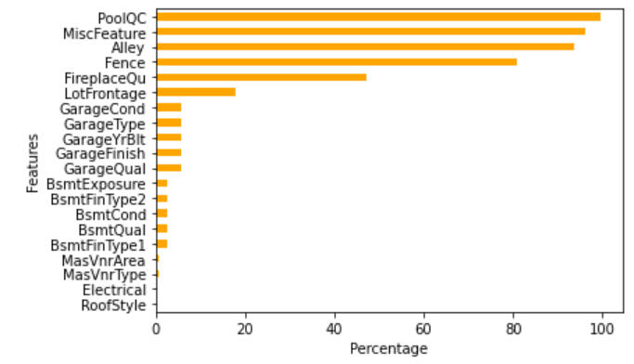
Approach
Performing an EDA
Exploring basic statistics of the datasets features and our target
Perform needed cleaning/wrangling such as imputing an attribute by the mean

Slide 4
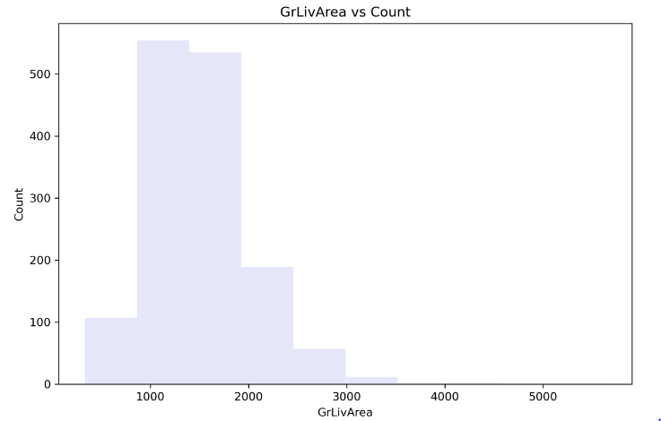
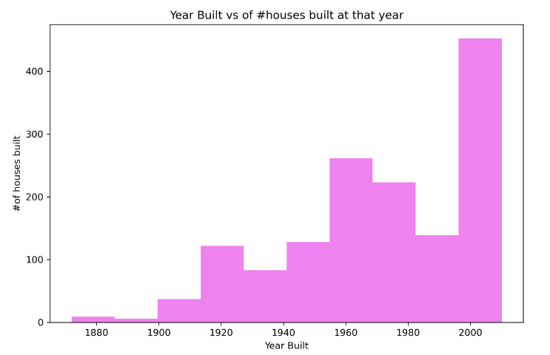
Approach
Visualizing the relationship between features resulted in key insights about the data.
Most houses occupy an area between 1000 to 2000 square feet.
The last 20 years witnessed a boom in real-estate. A good number of houses in Ames were built in the 21st century.

Slide 5
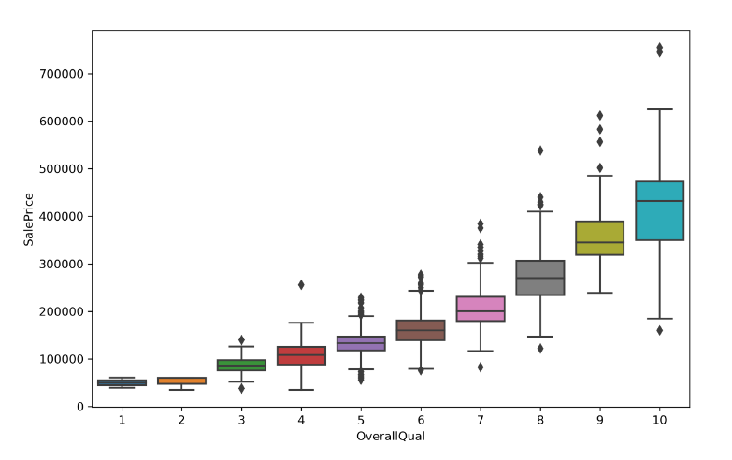
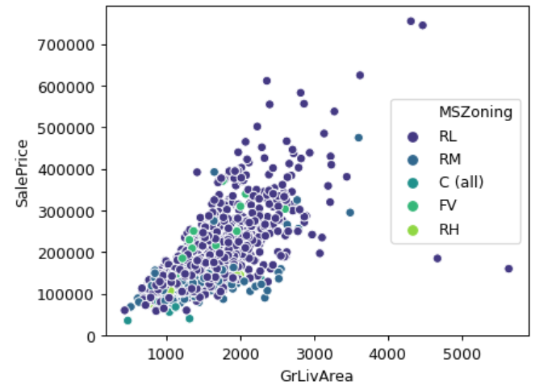
Approach

Slide 6
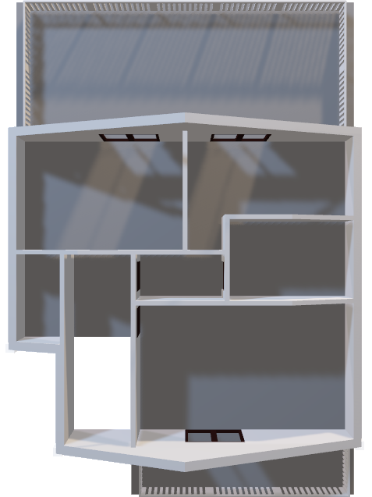
Modeling
Linear regressors such as OLS, RANSAC, and Decision Trees were used.
The data was modeled twice.
The first model features were all numeric in nature such as ‘Over all Quality’.
The second model included some categorical features such as ‘Neighborhood’

Slide 7
Modeling
Features where majority of attributes are ‘nulls’ were dropped such as ‘PoolQC’.
Features where a certain attribute occurred frequently were dropped such as ‘BsmtCond’.
Features where number of ‘nulls’ is small, the meas was used for imputing.

Slide 8
Modeling
In model 1:
Features having a high correlation with our target were fitted.
Correlations > ~0.5
Features where a certain attribute occurred frequently were dropped such as ‘BsmtCond’.
Features where number of ‘nulls’ is small, the mean was used for imputing.

Slide 9
Metrics of Model 1
Linear Regression Metrics
MAE: 25344.42
MSE: 1482932034.50
RMSE: 38508.86
MedianAE: 19812.97
R2: 0.75
TheilSen Metrics
MAE: 29365.46
MSE: 1907724396.03
RMSE: 43677.50
MedianAE: 20980.33
R2_score: 0.68
RANSAC Metrics
MAE: 27234.73
MSE: 1702373730.21
RMSE: 41259.83
MedianAE: 19223.01
R2_score: 0.72
Huber Metrics
MAE: 26571.35
MSE: 1765317532.02
RMSE: 42015.68
MedianAE: 16603.27
R2: 0.71

Slide 10
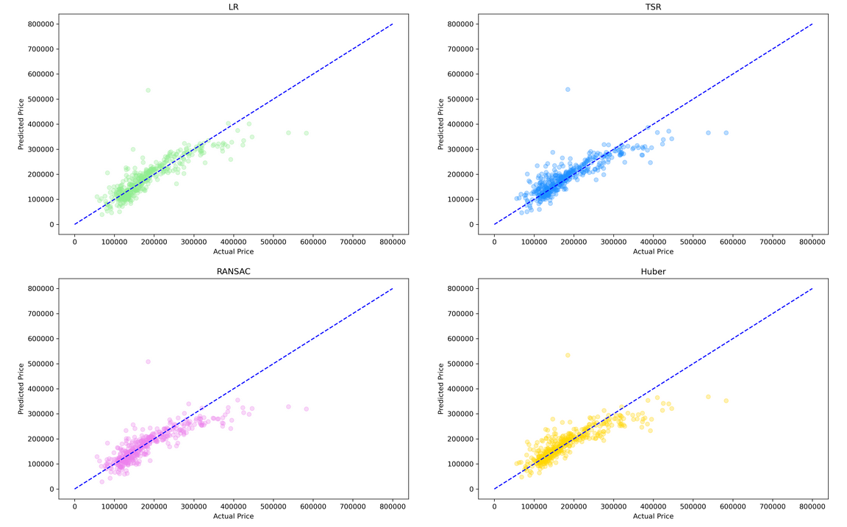
Plots of Model 1

Slide 11
Metrics of Model 2
Linear Regression Metrics
MAE: 22996.04
MSE: 1210757381.26
RMSE: 34795.94
MedianAE: 16342.31
R2_score: 0.80
TheilSen Metrics
MAE: 21432.37
MSE: 1215354792.95
RMSE: 34861.94
MedianAE: 14092.23
R2_score: 0.80
RANSAC Metrics
MAE: 23471.34
MSE: 1388390841.19
RMSE: 37261.12
MedianAE: 15367.56
R2_score: 0.77
Huber Metrics
MAE: 26553.21
MSE: 1762758599.49
RMSE: 41985.22
MedianAE: 16455.80
R2_score: 0.71

Slide 12
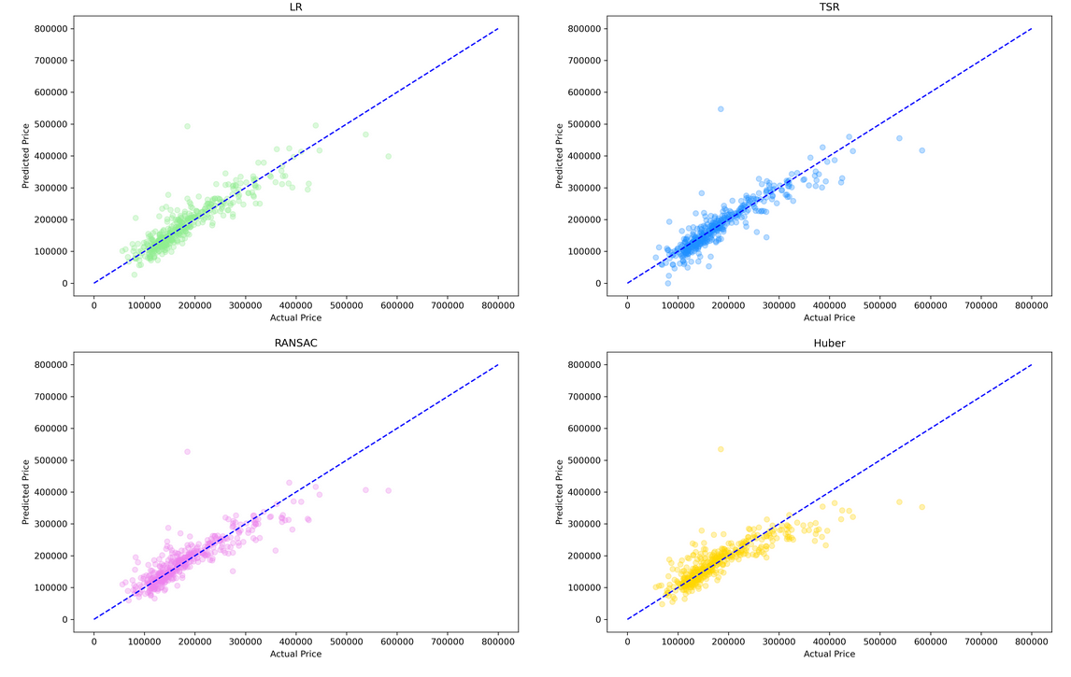
Plots of Model 2

Slide 13
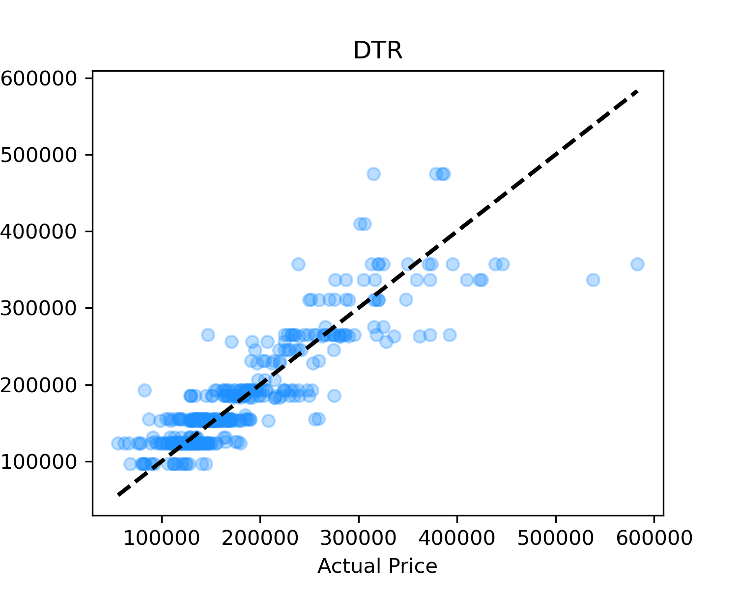
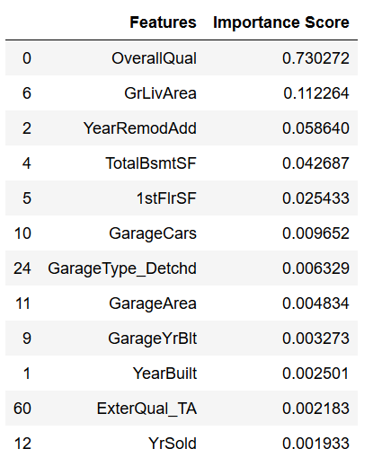
Metrics & Plot of DTR
DTR Metrics
MAE: 24957.05
MSE: 1372285806.65
RMSE: 37044.38
MedianAE: 16738.11
R2: 0.77

Slide 14
Modeling
When modeling with only numeric features, Linear Regression and RANSAC outperformed TheilSen and Huber
After including some categorical features, our models performed slightly better based on metrics.
Here, TheiSen and Linear Regression outperformed Huber and RANSAC
Surprisingly, the Decision Tree regressor performed poorly when compared to the other models.
A max depth of 6 was found to have the most optimal result.
Also, based on 'feature importance metric', 'OverallQual' had the highest score of 0.73
The rest had a significantly lower importance
A possible approach to modeling this set would be to drop the extreme outliers and check how would that impact performance
Also, increase the sample size

